Slide 1
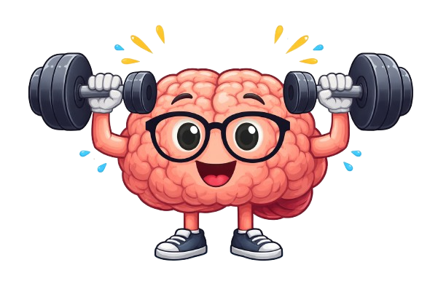
AI-Based Health and Fitness App
System Design
The Fitness Scholars

Slide 2
Agenda
Architecture Overview
System Structure
Data Flow Architecture
Component Description
UML Class diagram
ER Diagram
UI Mock-Ups
Version Control Section

Slide 3
Architecture Overview
The application uses a simple layered architecture with four main parts: the frontend, backend, database, and AI engine. The frontend allows users to interact with the app and view their workout plans. The backend, built with Python, processes user requests and manages the app’s logic. The database stores user information, workout history, and generated plans. The AI engine analyzes user data to create personalized workout plans that improve over time. All components communicate through secure APIs to ensure smooth and organized system operation.

Slide 4
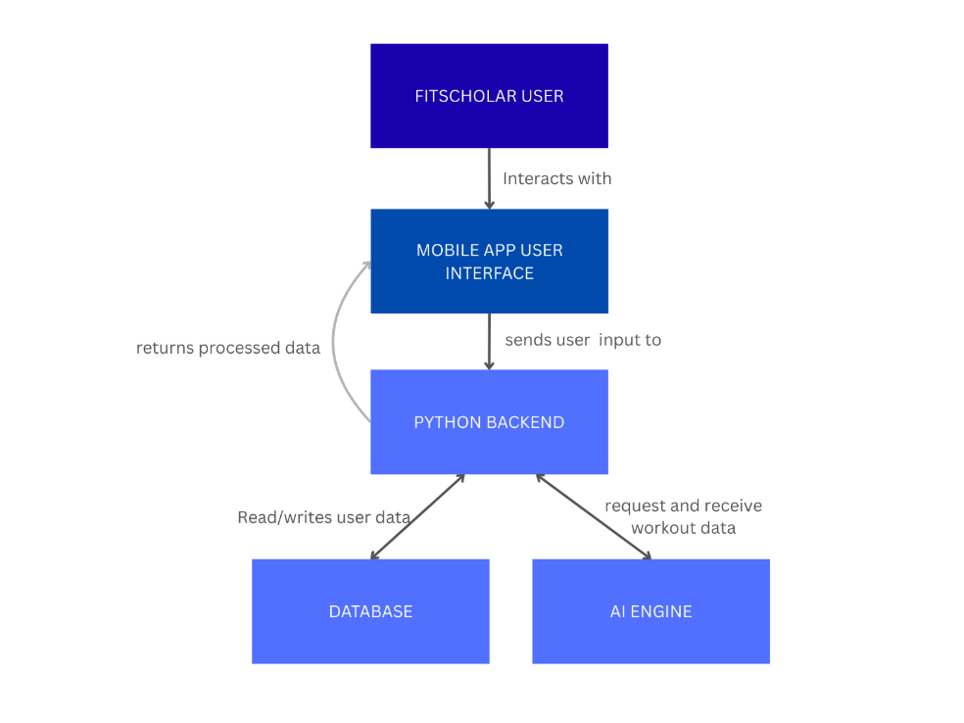
System STRUCUTRE
Our app uses a layered architecture with four main components: the frontend, Python backend, database, and AI engine. The frontend sends user requests to the backend, which processes the data, stores it in the database, and communicates with the AI engine to generate personalized workout plans.

Slide 5
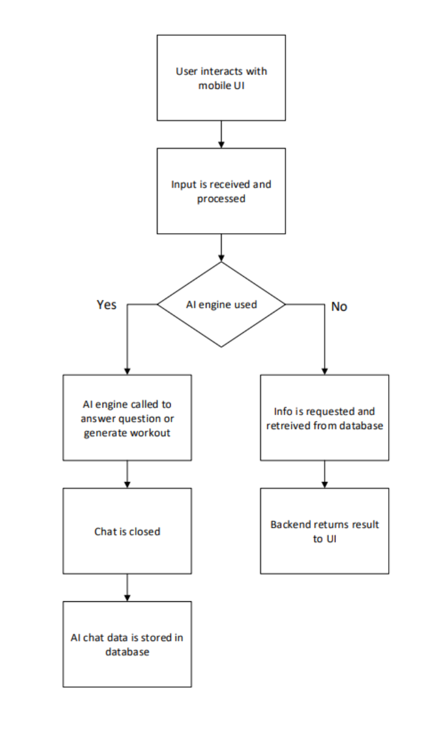
Data Flow Architecture
The data flow begins when a user interacts with the app and submits a request. The system processes the input and checks whether an AI-generated workout plan is needed. If AI is required, the system generates a new workout plan and stores it in the database. If not, it retrieves existing data from the database. Finally, the backend sends the results back to the user interface for display.

Slide 6
Component Description
Frontend (UI Layer) The frontend displays the app interface and allows users to view workout plans, schedules, and dashboards. It sends user inputs to the backend and displays the results it receives.
Backend (Python Layer) The backend processes user requests, manages the app’s logic, and connects all components together.
Database Layer The database stores user profiles, workout history, feedback, and generated plans. It communicates directly with the backend to save and retrieve data.
AI Engine The AI engine uses OpenAI and machine learning to analyze user data and generate personalized workout plans that improve over time.

Slide 7
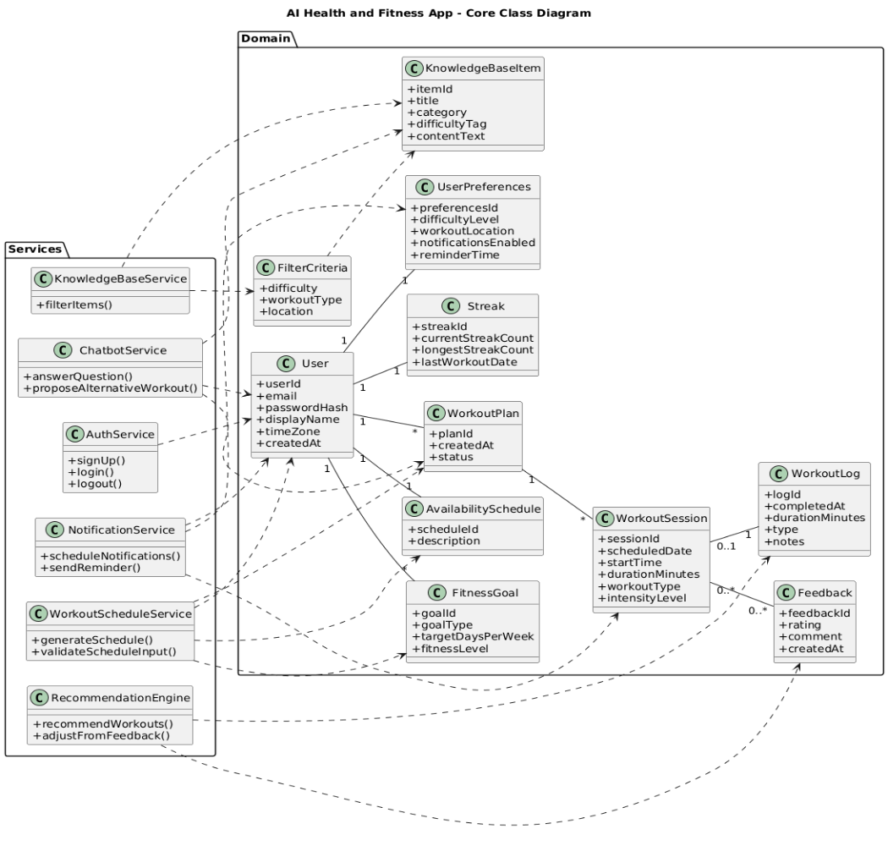
UML Class diagram-System Structure
Domian Layer • Core system data and entities • Central class: User • User connects to User Preferences, Availability Schedule, Goals, Workout Plans, and Streak • WorkoutPlan → multiple WorkoutSessions • WorkoutSession → WorkoutLog and Feedback • KnowledgeBaseItem supports workout content and filtering
Service Layer • Business logic layer – Perform actions • AuthService handles accounts • WorkoutScheduleService creates plans • RecommendationEngine adapts workouts • ChatbotService provides AI support • KnowledgeBaseService filters content • NotificationService manages reminders
• Each class includes key attributes like IDs, dates, difficulty levels, and status fields that define the data stored in the system.
Relationships • Solid lines = structural associations • Dashed arrows = dependencies on domain classes

Slide 8
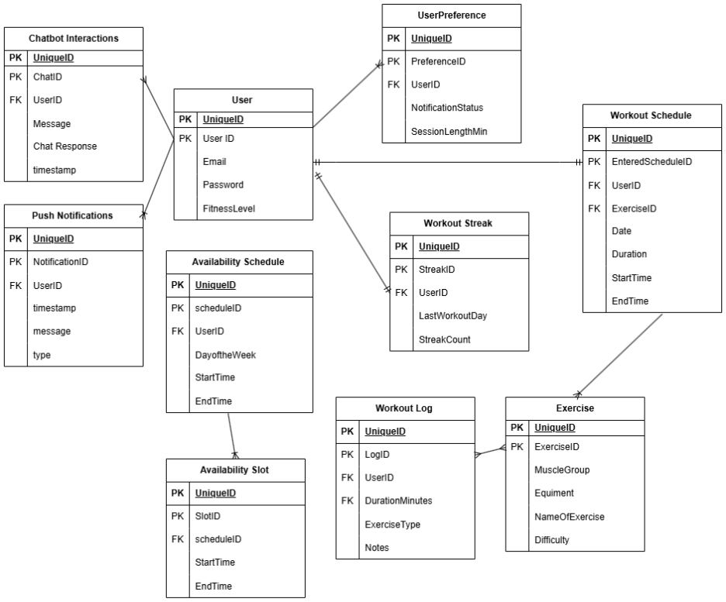
ER Diagram
ER diagram represents the main database structure of our fitness application. It shows the key entities such as User, Workout Schedule, Workout Log, Exercise, and User Preferences, along with how they are connected through relationships. The User class is the central part of the system, linking to schedules, logs, streaks, notifications, and chatbot interactions. The diagram helps us understand how user data is organized, stored, and related within the system.
Each table contains a primary key that uniquely identifies its records, ensuring entity integrity. Foreign keys are used to reference primary keys in related tables, which establishes relationships and enforces referential integrity. For example, WorkoutLog contains UserID as a foreign key that links each log to a specific user.
Notes:
Junction table needed for the many to many relationship

Slide 9
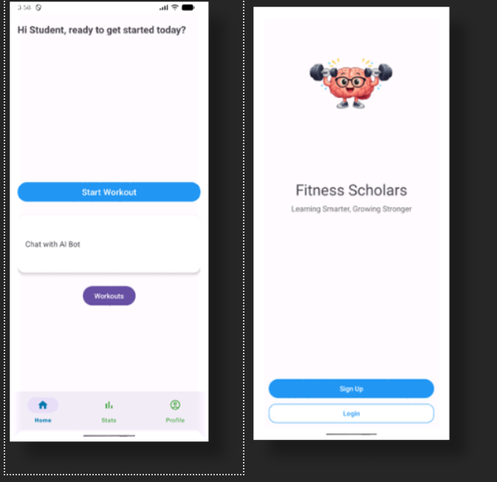
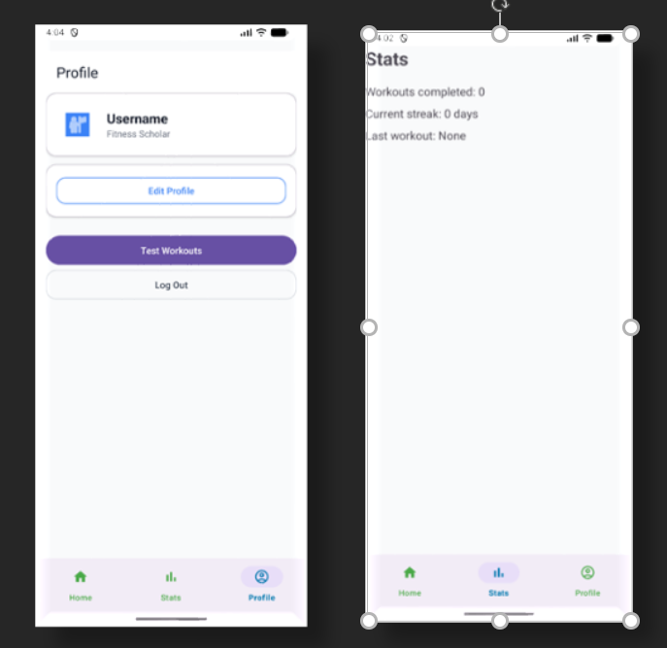
UI Mockups
These UI mockups show the main screens of our fitness app. When users open the app, they can either sign up or log in. After logging in, they are taken to the Home screen, where they can start a workout or chat with the AI bot for fitness guidance.
The Stats page shows the user’s progress, including completed workouts and streak information. The Profile page allows users to update their preferences and settings, which helps personalize their workout plans. A navigation bar at the bottom makes it easy to switch between Home, Stats, and Profile.

Slide 10
Version Control
We use GitHub as our version control system to manage our source code and project files. It allows all team members to work together, track changes, and safely combine updates. We use branches to organize different parts of the project, and pull requests to review and merge code. GitHub also helps us communicate through README files and track development progress and commit messages document the purpose of each change. Overall, it keeps the team up to date with any modifications to the system, accountability, and a reliable mechanism that can recover previous versions in case of any errors occur.

